Slide 1
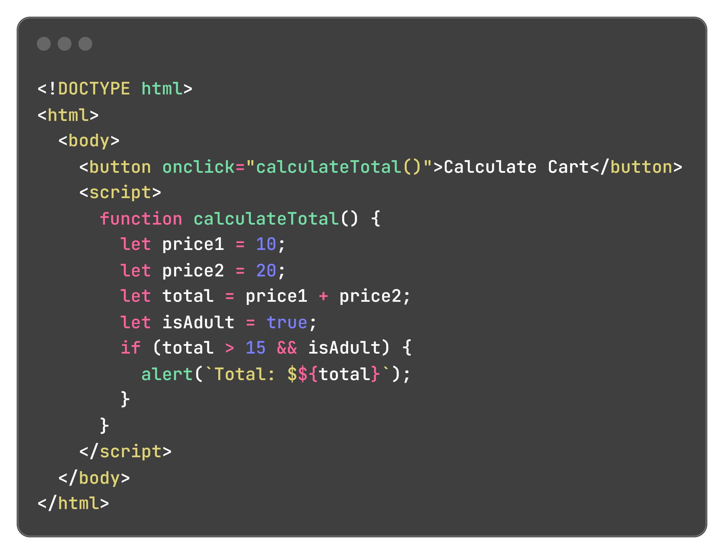
What kind of calculations or decisions does a website need to make?

Slide 2

Arithmetic operators
Used to perform mathematical operations on numbers (integers or floating-point).
Operate on variables or literals (e.g., 5 + 3).
Commonly used for calculations like totals, discounts, or game scores.

Slide 3
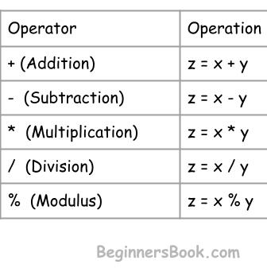
List of arithmetic operators

Slide 4
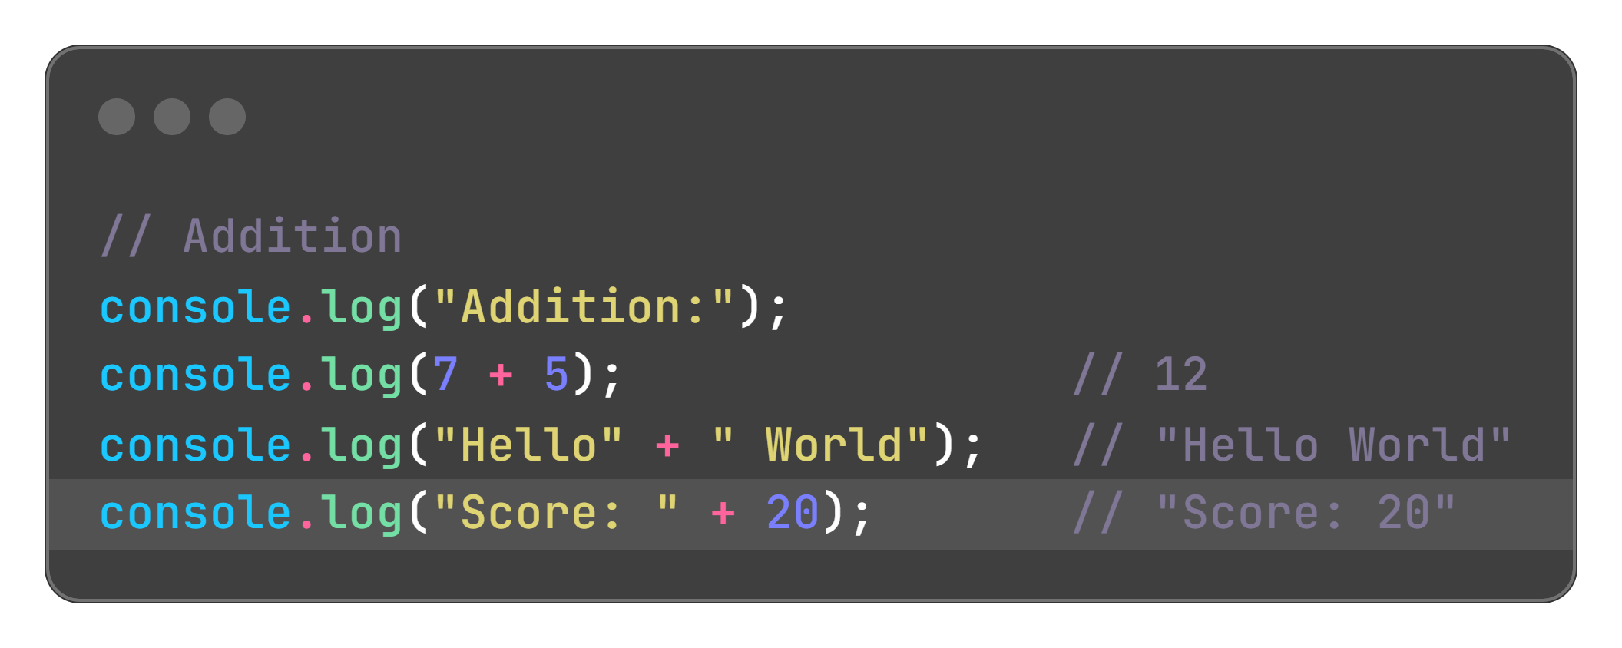
Addition

Slide 5
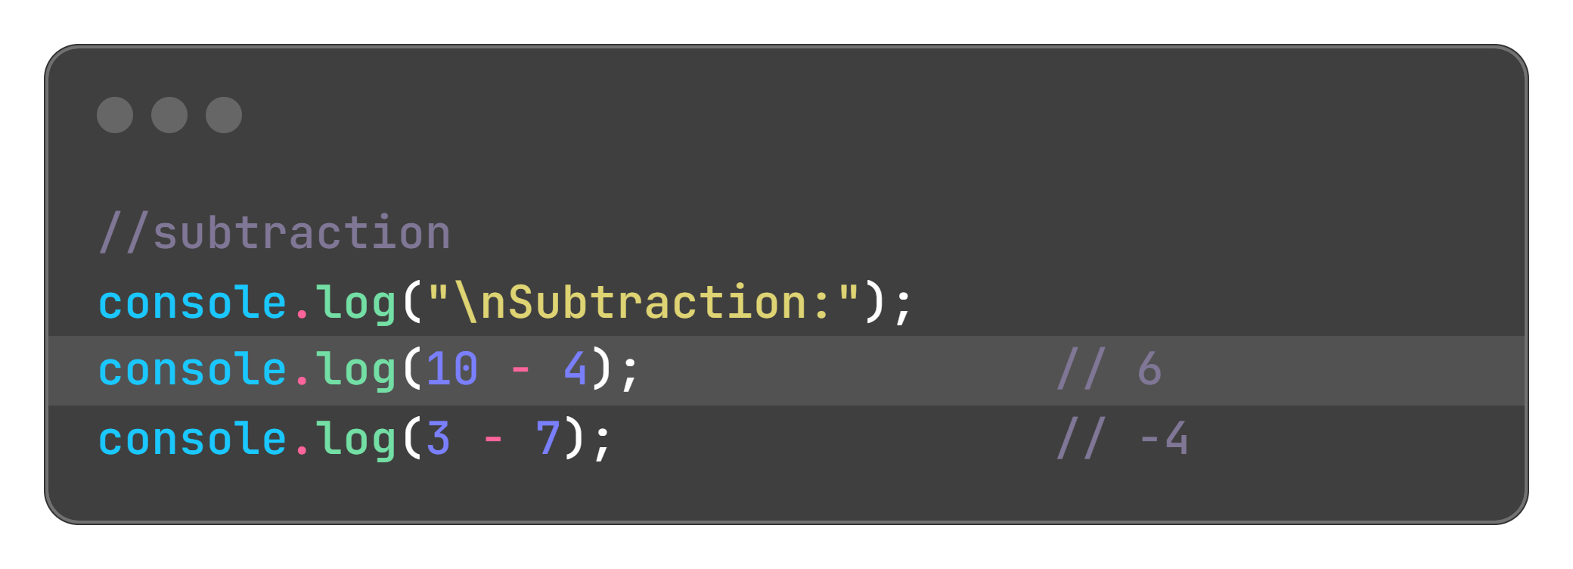
Subtraction

Slide 6
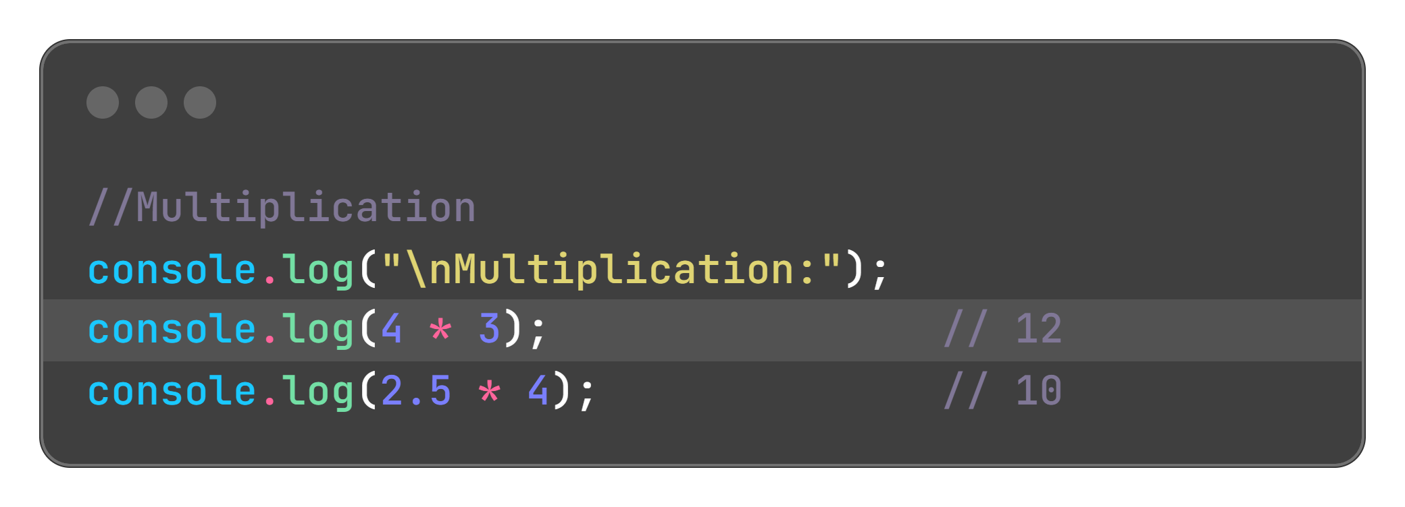
Multiplication

Slide 7
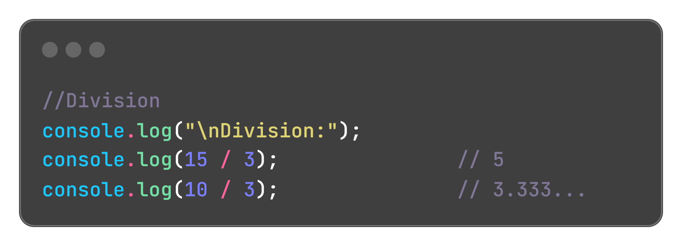
Division

Slide 8
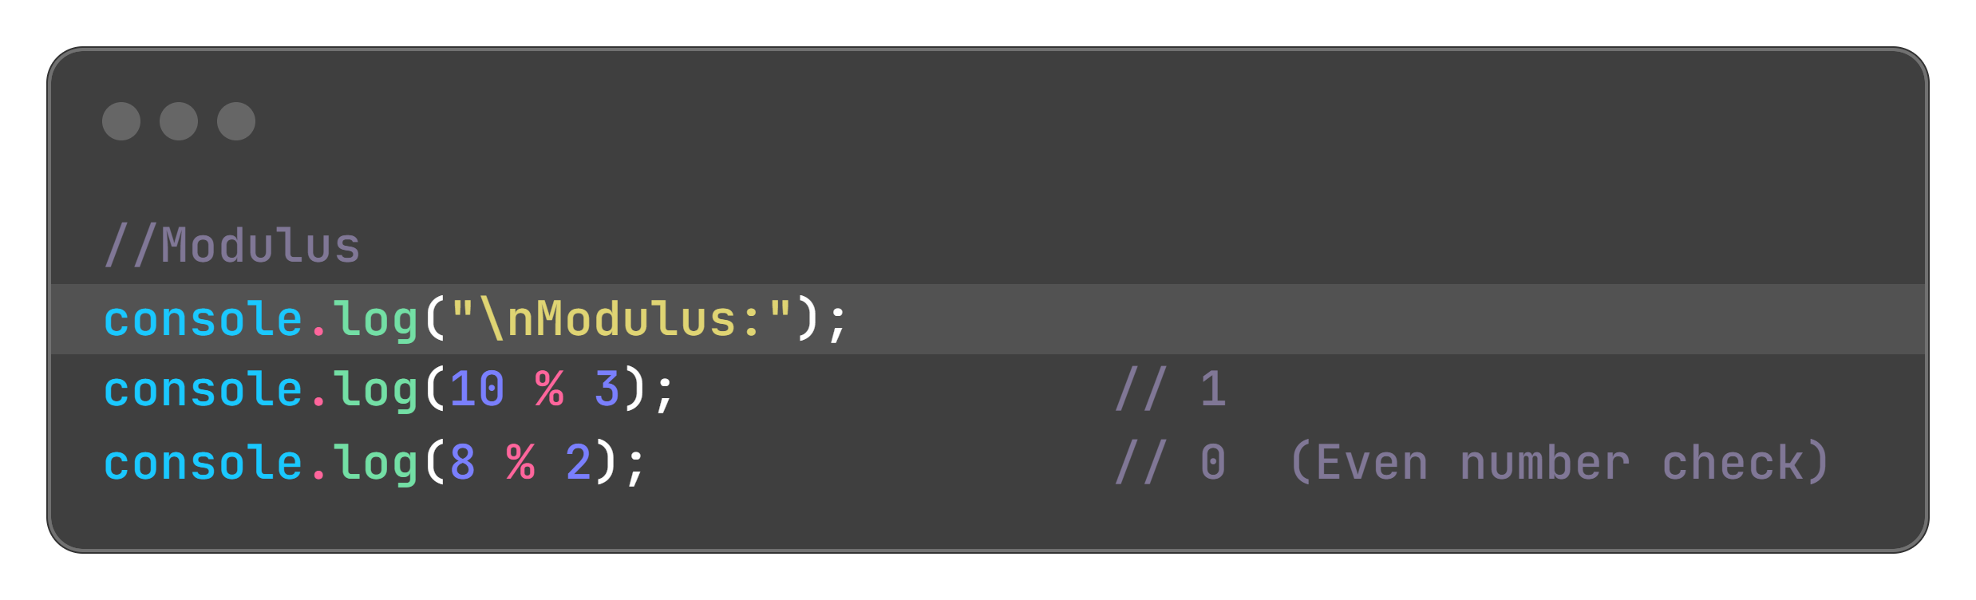
Modulus

Slide 9
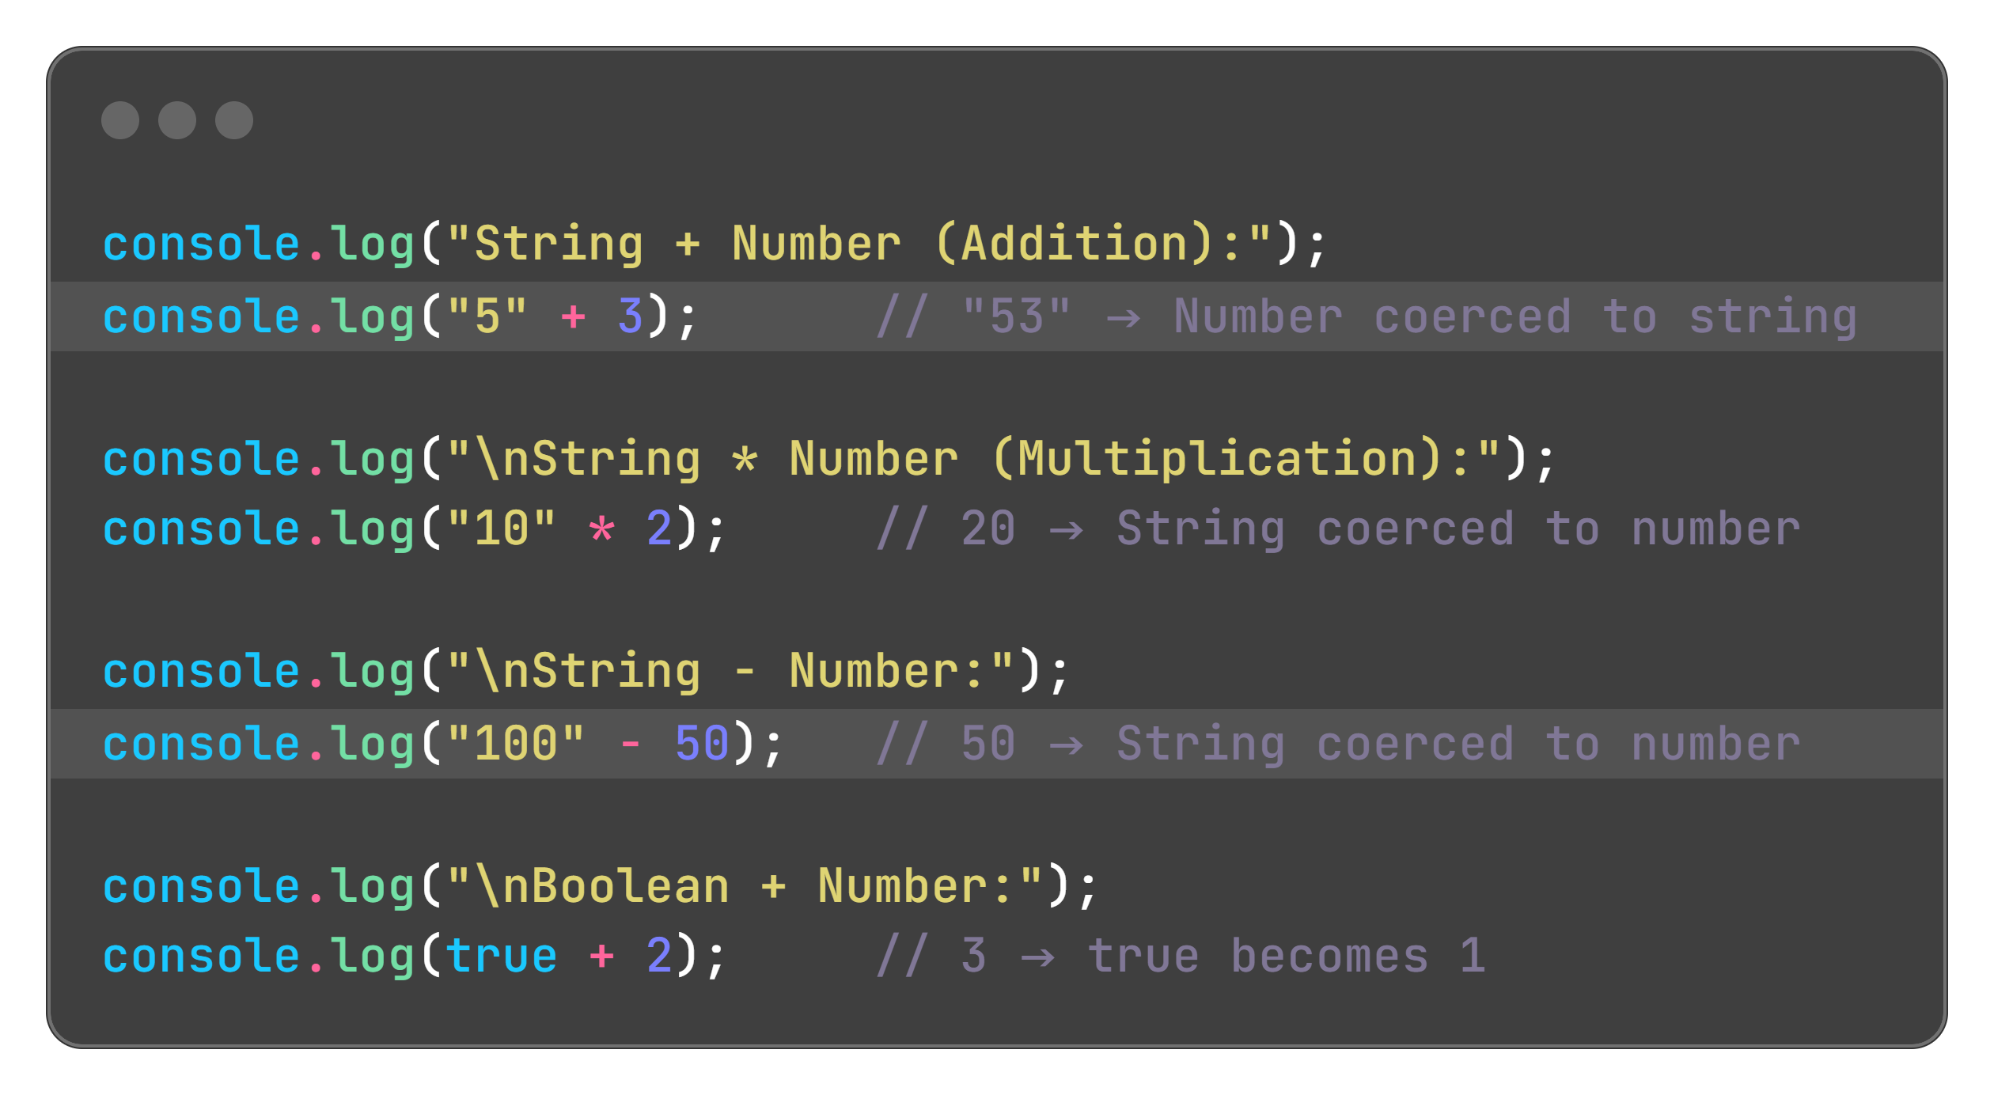
Type-coercion

Slide 10
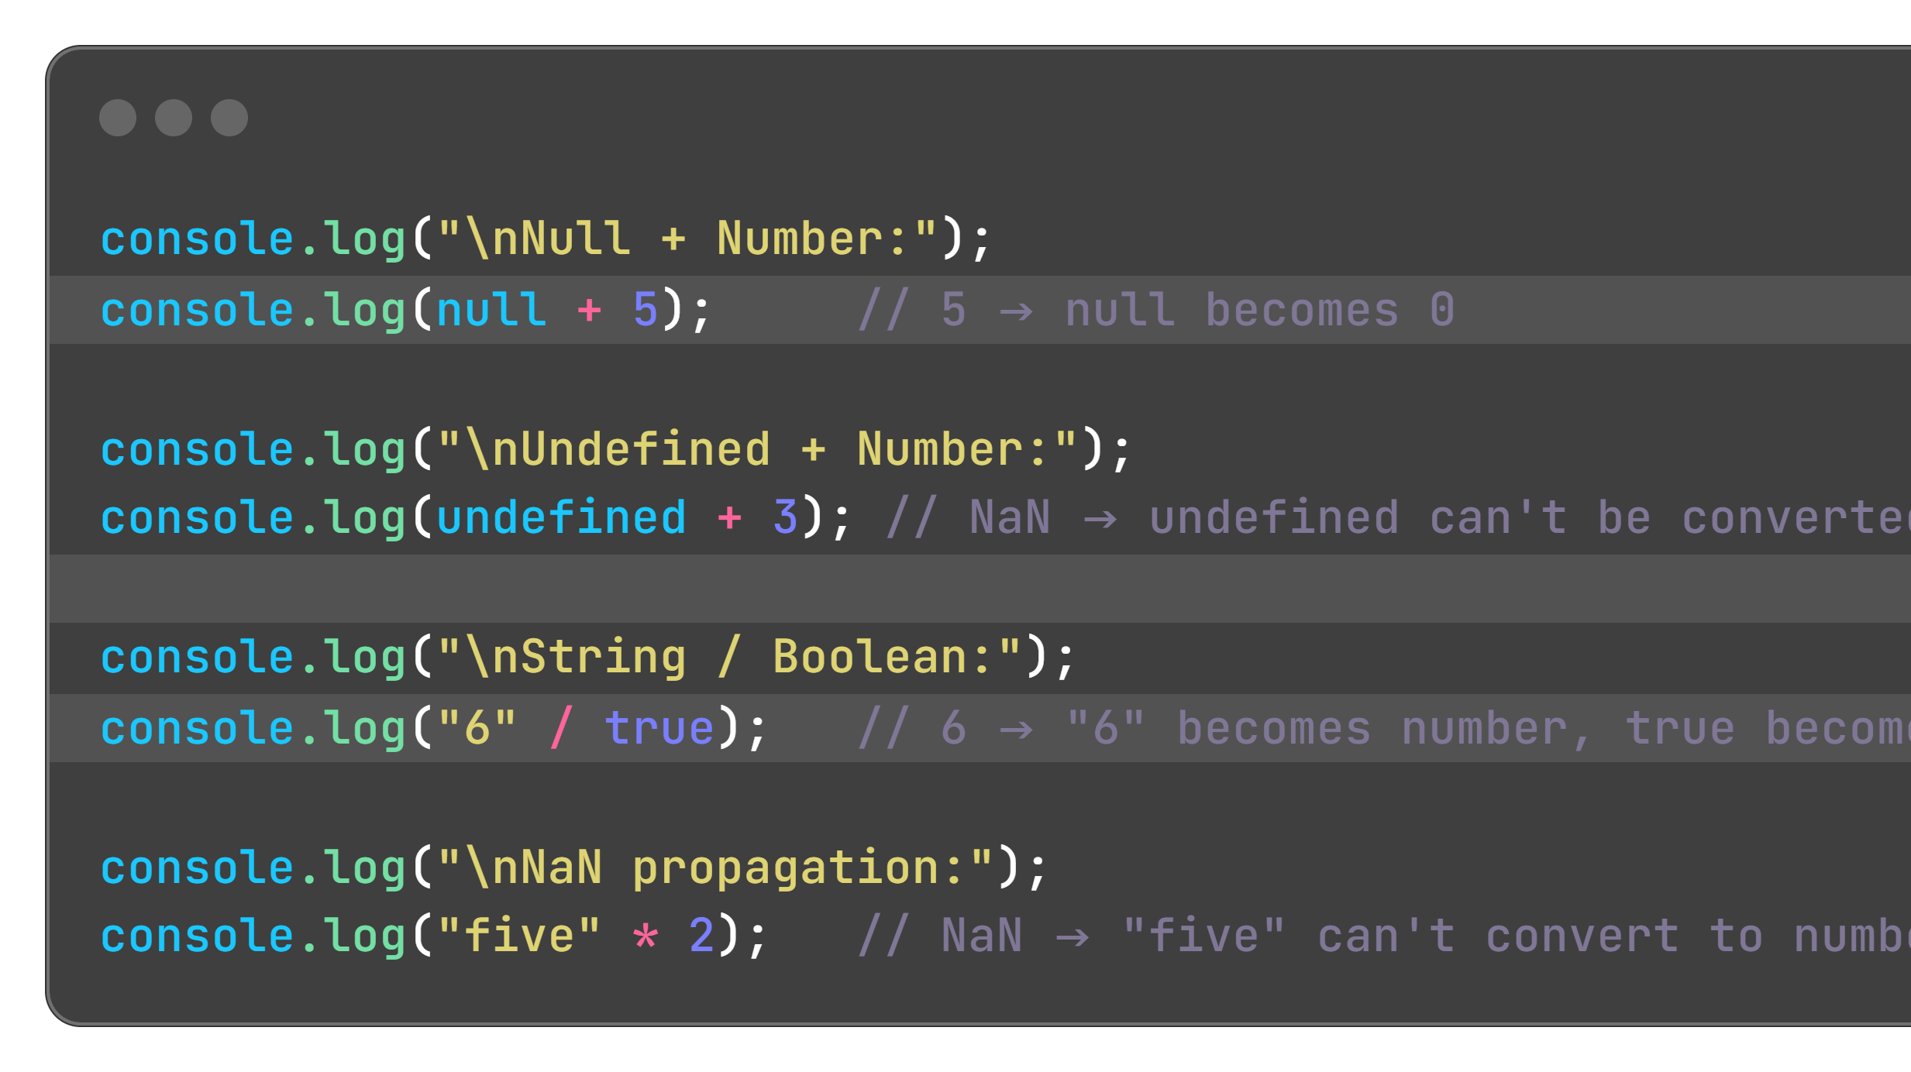
Type-coercion

Slide 11
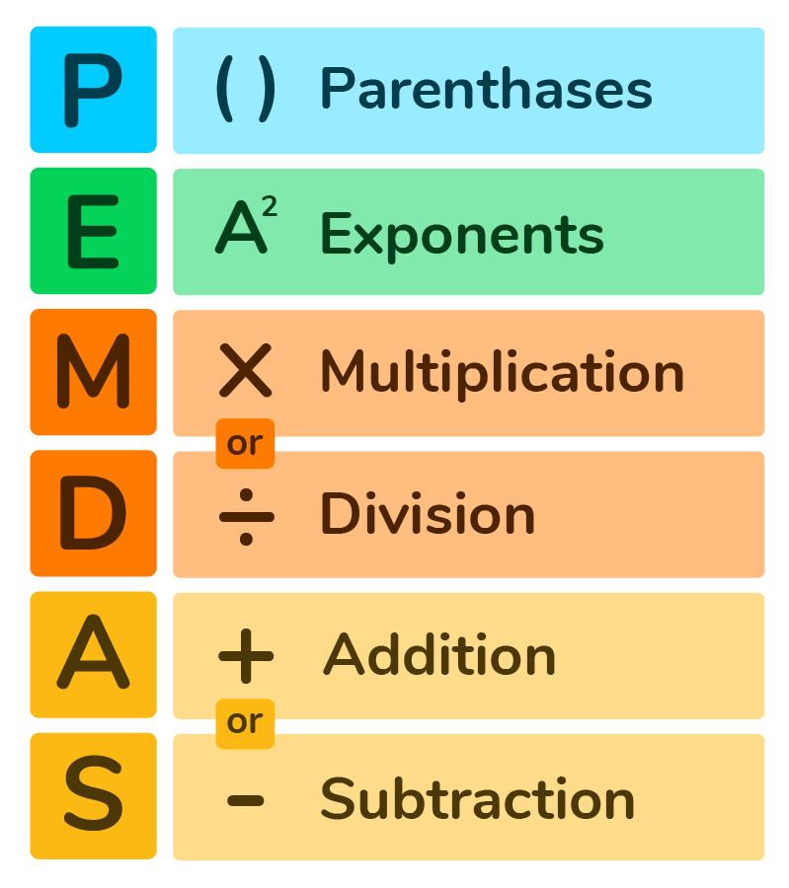
Precedence
Follows PEMDAS (Parentheses, Exponents, Multiplication/Division, Addition/Subtraction).

Slide 12
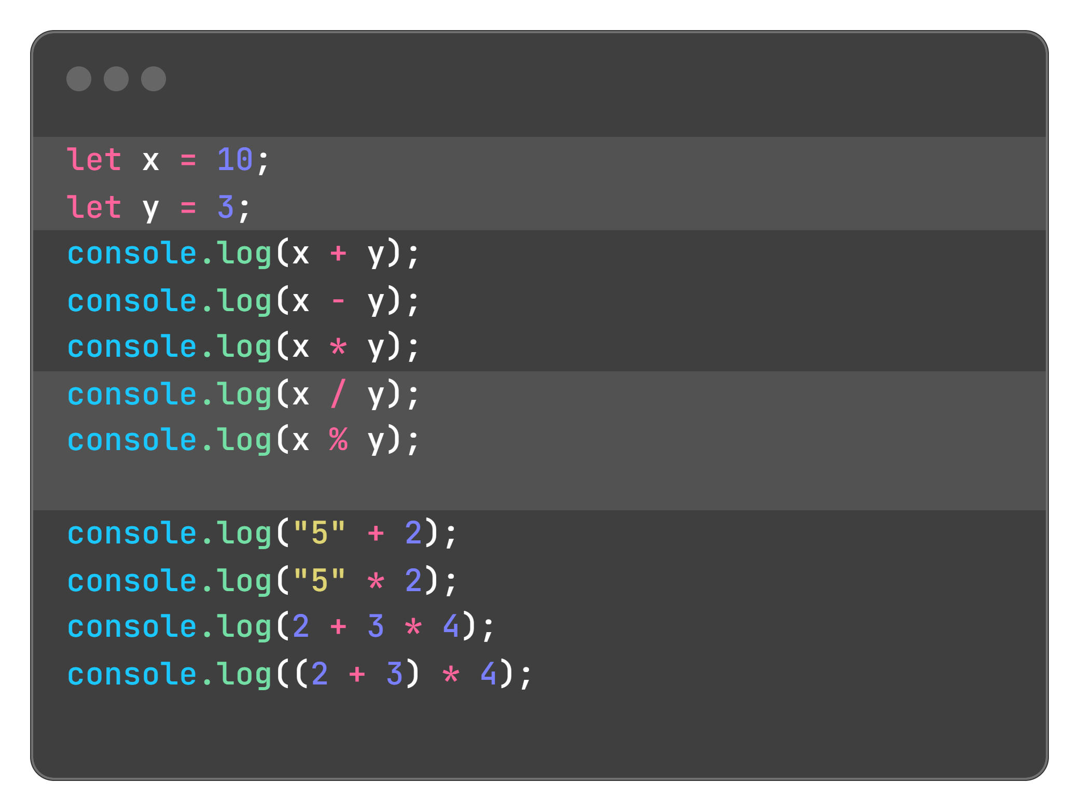
Let's solve this

Slide 13

Real-World Use:
Calculating totals in e-commerce.
Updating game scores or timers.
Determining positions in animations (e.g., moving an element by x + 10 pixels).

Slide 14
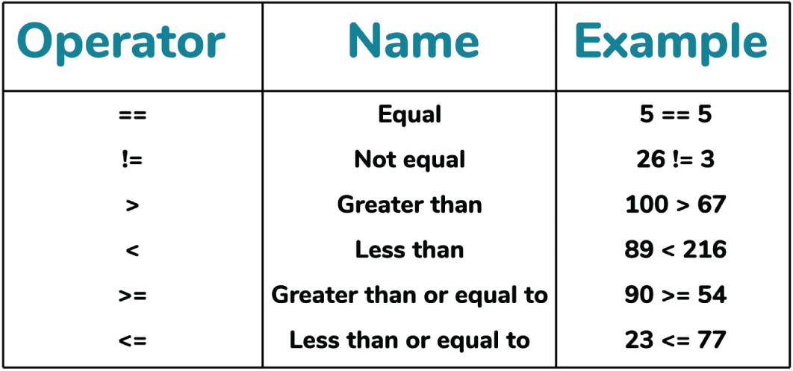
Comparison Operators

Slide 15
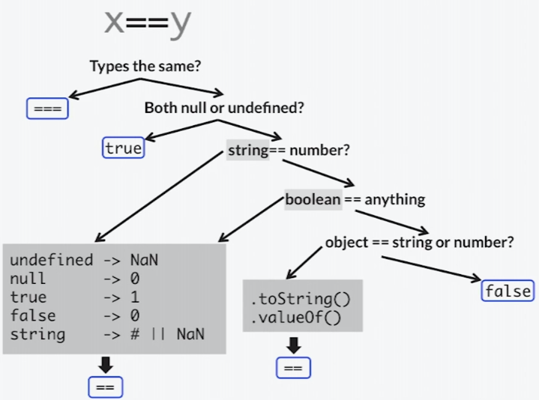
What are Comparison Operators?
Used to compare two values, returning a boolean (true or false).
Essential for decision-making in code (e.g., if statements, loops).

Slide 16
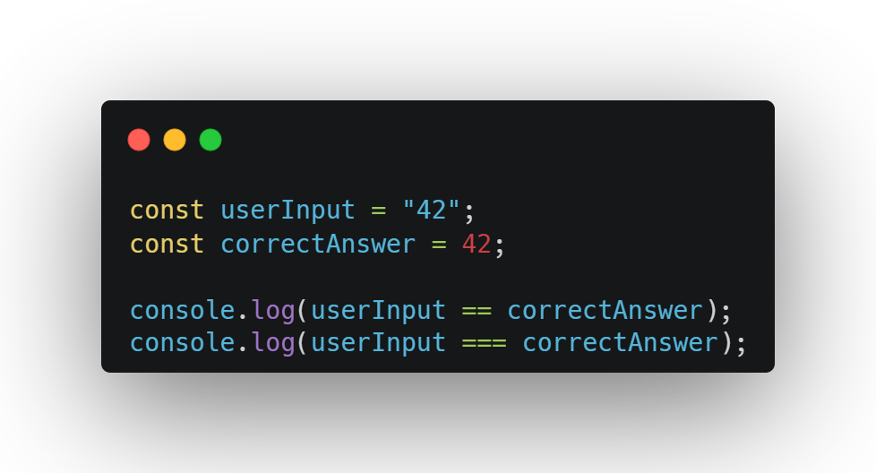
Loose vs strict equality

Slide 17
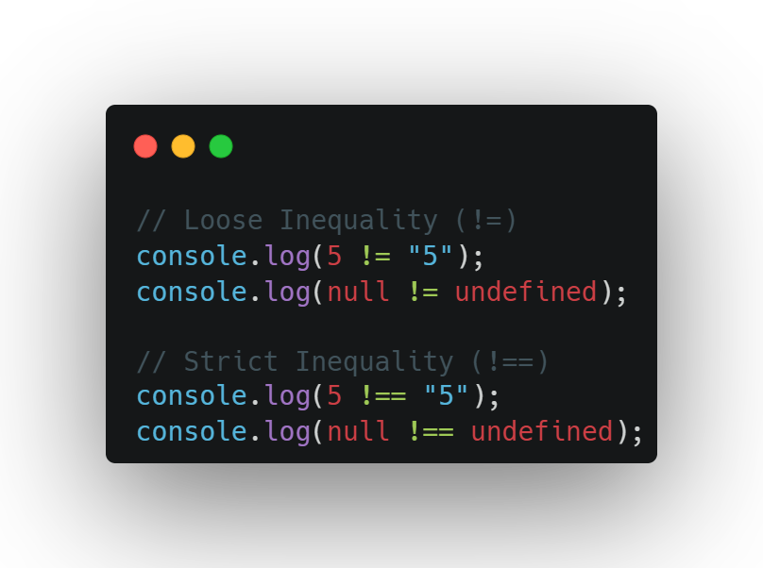
Loose inequality vs strict inequality

Slide 18
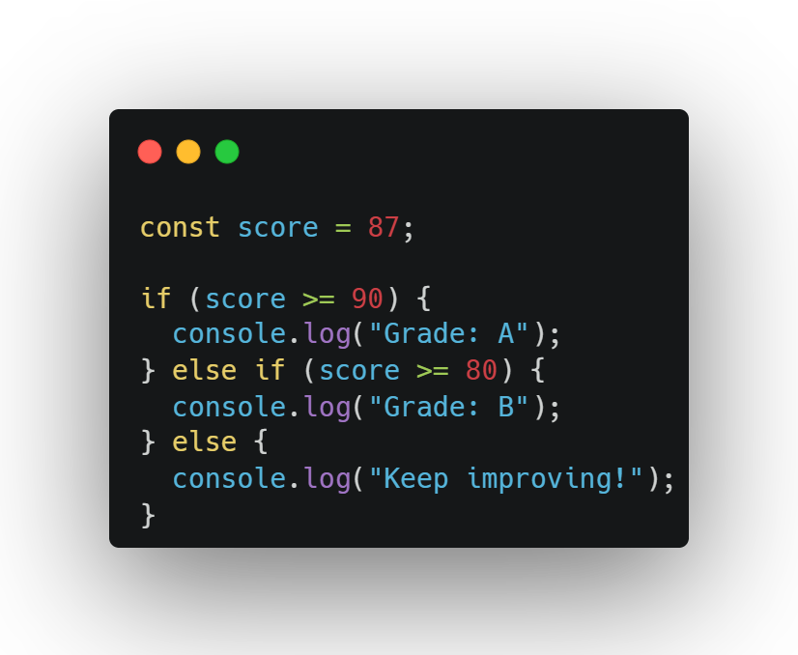
Comparing scores

Slide 19
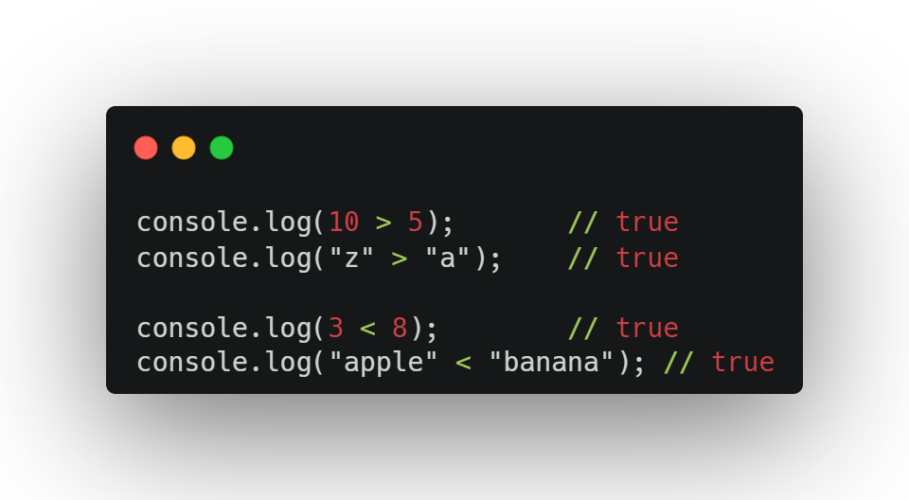
> Vs <

Slide 20
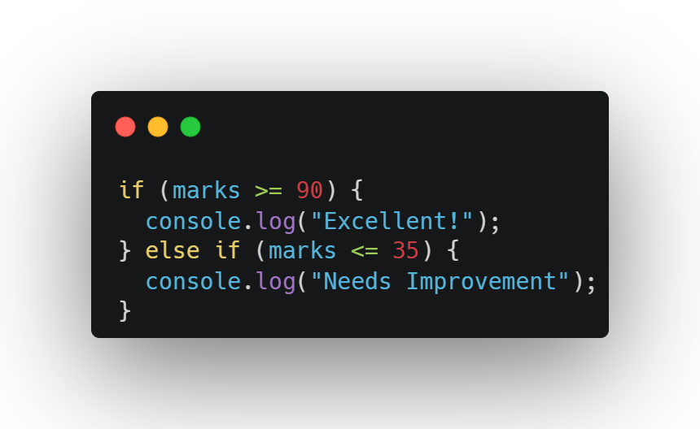
>= Vs <=

Slide 21
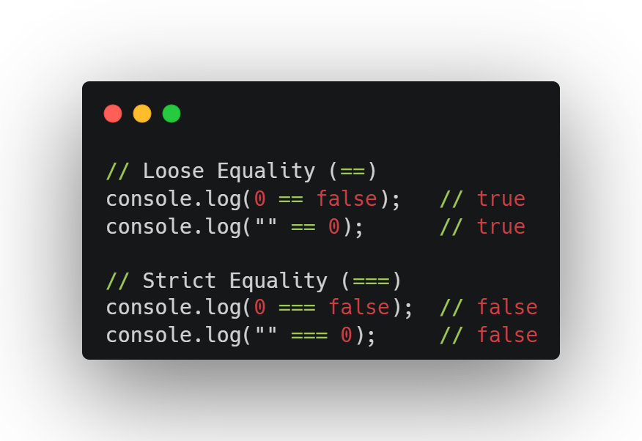
Always Use === Instead of ==
to avoid unexpected coercion.

Slide 22
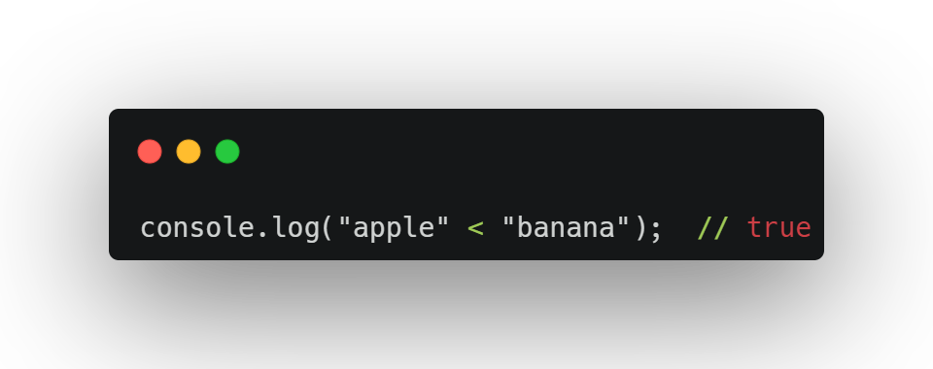
Comparing Different Types
Compared alphabetically (like in a dictionary).

Slide 23
null and undefined
null == undefined → true (JavaScript treats them as loosely equal)
null === undefined → false (they’re different types)

Slide 24
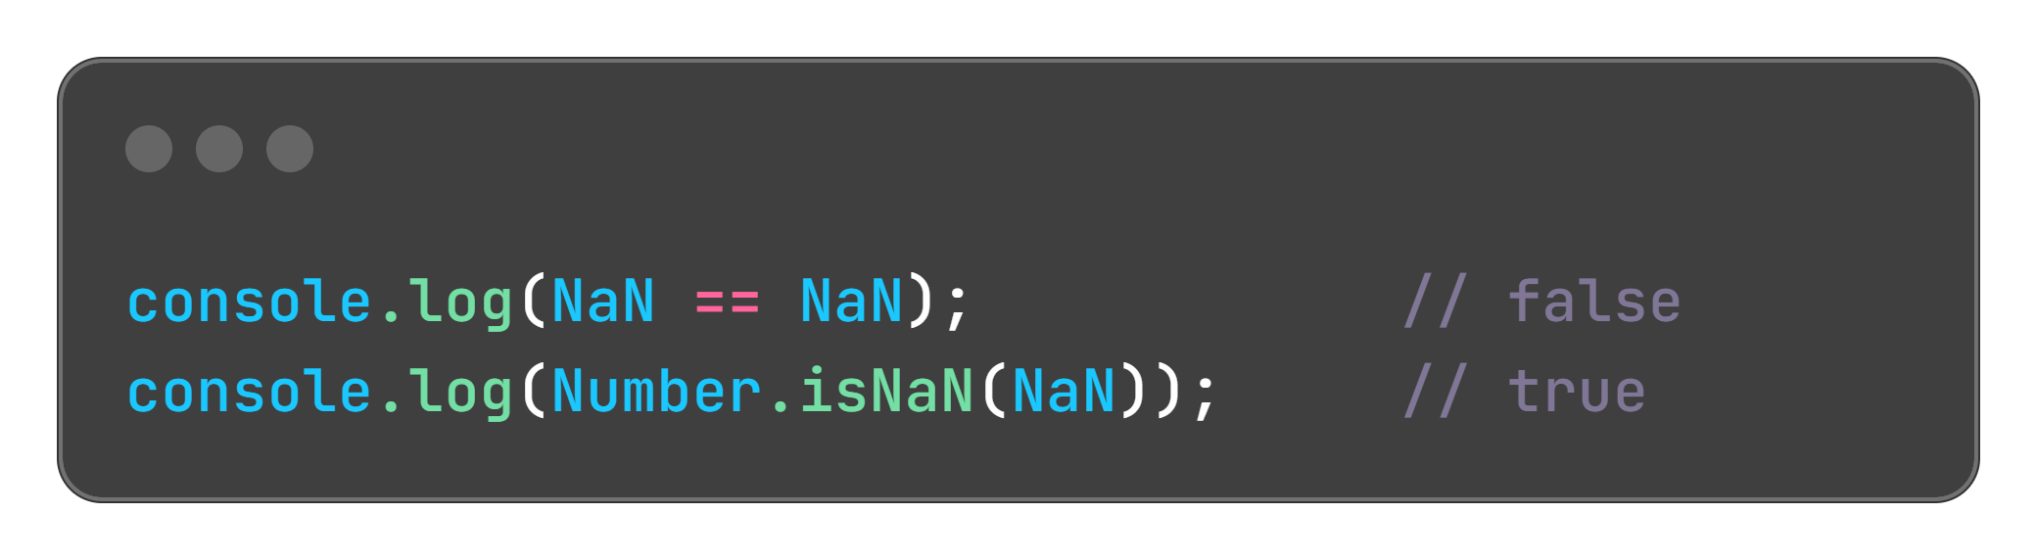
Weird but true
NaN is not equal to anything, not even itself!

Slide 25
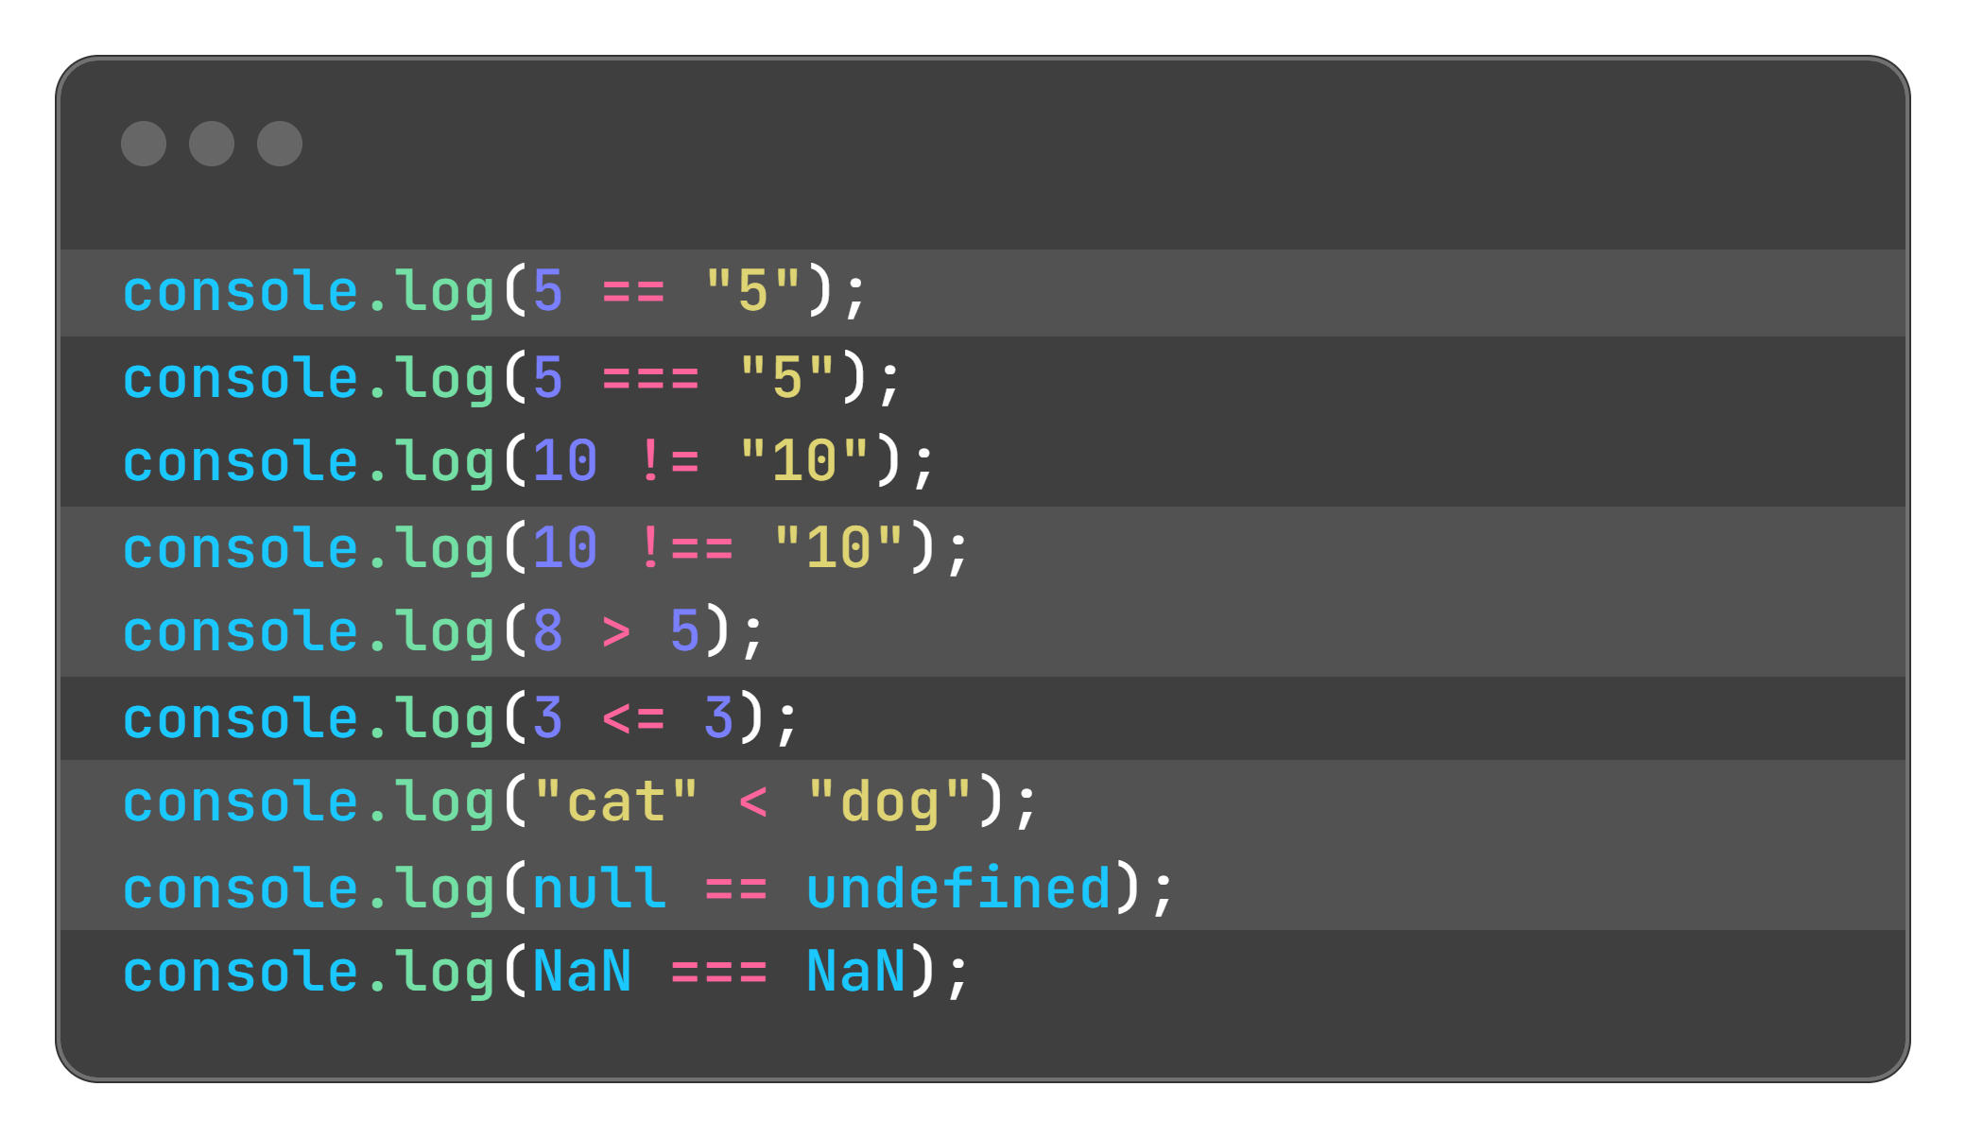


Slide 26

Real-World Use:
Form validation (e.g., age >= 18 for adult content).
Sorting data (e.g., price1 < price2).
Conditional rendering (e.g., show a button if user !== null).

Slide 27
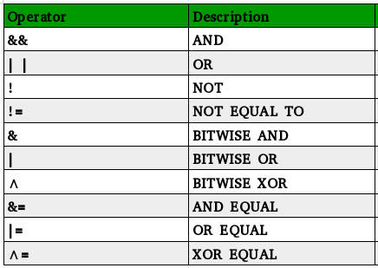
Logical Operators

Slide 28
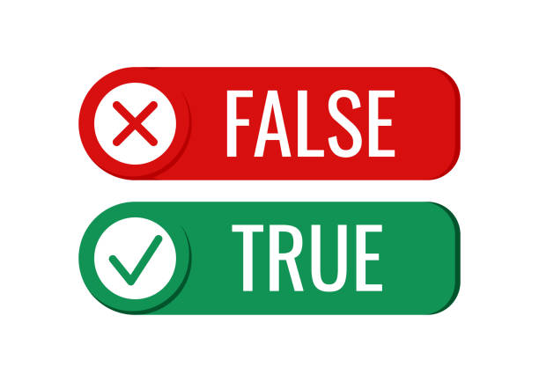
What are Logical Operators?
Used to combine or manipulate boolean values (true/false).
Essential for complex conditionals (e.g., if statements).

Slide 29
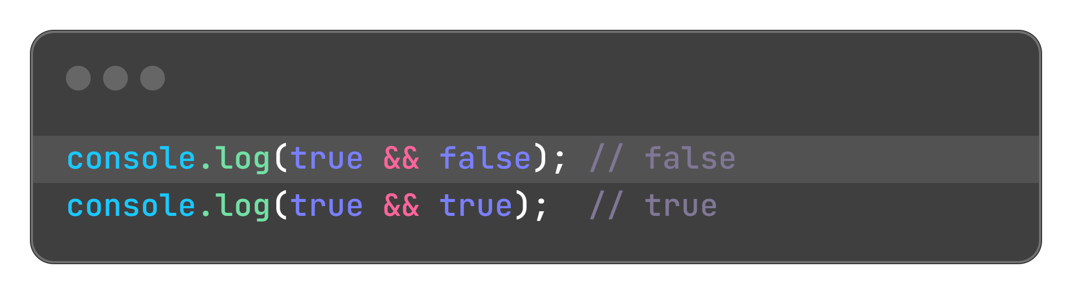
Logical and (&&)
Returns true only if both conditions are true.

Slide 30
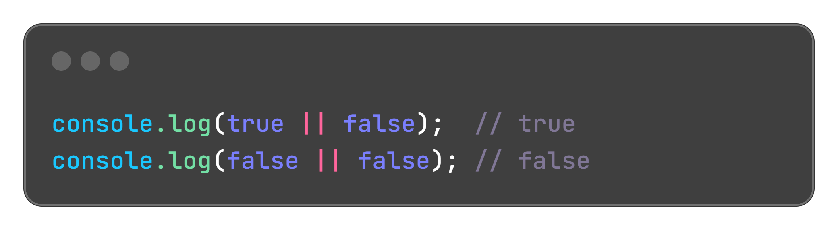
Logical or (||)
Returns true if at least one condition is true.

Slide 31
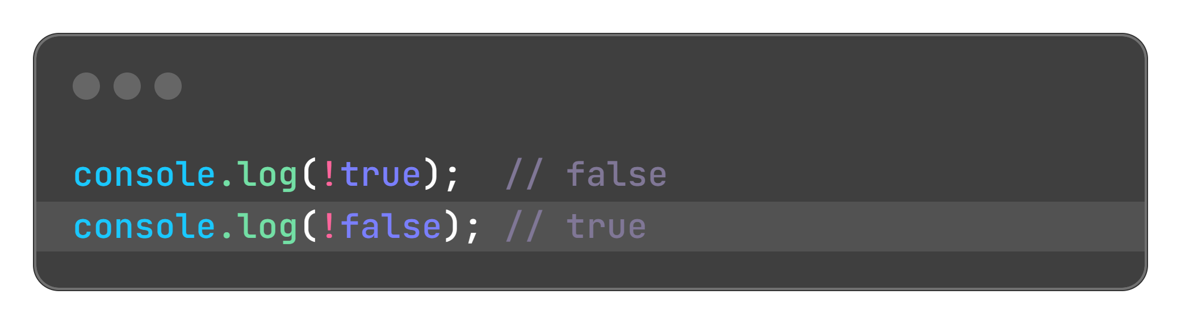
Logical not (!)
Flips the boolean value—true becomes false, and vice versa.

Slide 32

What is Short-Circuit in JavaScript?
JavaScript checks from left to right. If it already knows the answer, it stops early.

Slide 33
With AND (&&):
If the first thing is false, it stops
Why? Because false && anything is always false — so it doesn’t check the second part.

Slide 34
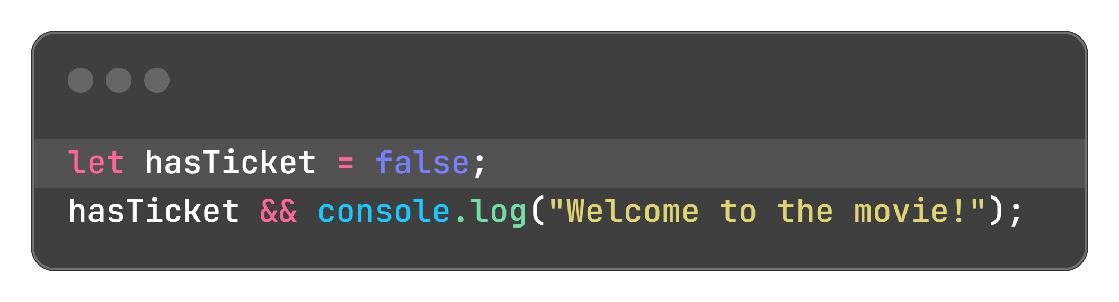
With AND (&&):
If the first thing is false, it stops
Why? Because false && anything is always false — so it doesn’t check the second part.

Slide 35
With OR (||):
If the first thing is true, it stops
Why? Because true || anything is always true — so it doesn’t check the rest.

Slide 36
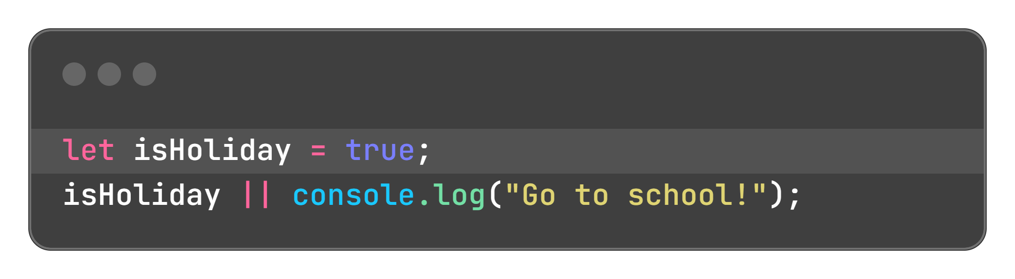
With OR (||):
If the first thing is true, it stops
Why? Because true || anything is always true — so it doesn’t check the rest.

Slide 37
Exercise

Slide 38

Exercise 1: Arithmetic Operators
Declare variables for:
price (e.g., 50.99).
quantity (e.g., 3).
taxRate (e.g., 0.1 for 10%).
Calculate and log:
Total cost (price * quantity).
Tax amount (total * taxRate).
Final cost with tax (total + tax).
Remainder when dividing final cost by 10 (finalCost % 10).
Test coercion by adding a string price (e.g., "50.99") to a number.
Use parentheses to change precedence in an expression (e.g., (price + 5) * quantity).

Slide 39
Declare variables:
age (e.g., 25).
minAge (e.g., 18).
input (e.g., "25").
Log the results of:
age >= minAge
age == input
age === input
age != input
age !== input
Compare two strings (e.g., "apple" and "banana") using < and >.
Check if a variable is NaN using Number.isNaN().
Exercise 2: comparison Operators

Slide 40
Declare variables:
age (e.g., 25).
minAge (e.g., 18).
input (e.g., "25").
Log the results of:
age >= minAge
age == input
age === input
age != input
age !== input
Compare two strings (e.g., "apple" and "banana") using < and >.
Check if a variable is NaN using Number.isNaN().
Exercise 3: logical operators

Slide 41
Write code with a deliberate error (e.g., using == instead of === or incorrect precedence).
Use console.log to track values and identify the issue.
Fix the error and log the corrected result.
Add a coercion example (e.g., "10" * "2") and explain the result using console.log.
Exercise 4: Debugging with Operators

Slide 42
bonus Challenge
Create a “discount calculator” script:
Declare variables: price (number), quantity (number), hasCoupon (boolean), minPurchase (e.g., 50).
Calculate the total (price * quantity).
Apply a 10% discount if hasCoupon is true and total >= minPurchase.
Compare total with minPurchase using === and >.
Use console.log with a template literal to display the result (e.g., Final price: $45.00).
Example Output: Total: $60, Discount Applied: true, Final Price: $54

Slide 43


Slide 44

Recap...
JavaScript: Powers web interactivity, manipulates the DOM, runs in browsers.
Variables: Use const for constants, let for reassignable values, avoid var.
Scope: Global, local, block, and function scope; let/const are block-scoped.
Data Types: String, number, boolean, null, undefined; check with typeof.
Type Coercion: Implicit (automatic) vs. explicit (manual); use === and explicit conversion for clarity.

Slide 45

Thank-You !!!

